Slide 1
Chapter 11 & 12
CSS Style Sheets: Intro

Slide 2
Why CSS?
Separate presentation from content – more accessible
Less work – can change appearance of whole site by changing one style sheet
More precise layout control
Big pushback when originally introduced
www.csszengarden.com

Slide 3
How do they work?
Keep your html file the same
Write style rules for how you’d like certain things to look
Attach the style rules to the html document
External – text file ending in .css
Embedded – between <style> tags in <head>
Inline – right inside desired tag

Slide 4
Format of rules
Selector {
property1: value;
property2: value;
property3: value;
}
p {
font-size: small;
font-family: sans-serif;
}
Selector is an element type (h1, p, img)
Each element type has different properties that may be changed
List each one that needs to be changed and set its value

Slide 5
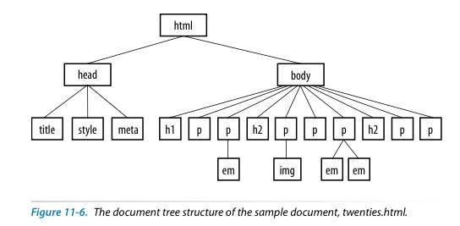
Inheritance
Some style properties get passed from parent to child, for example font-family and font-size
General:
Properties related to text get passed down
Properties related to boxed elements (padding, border, margins) do not
Benefit – don’t have to keep rewriting same rules

Slide 6
Conflicting Styles
How to resolve style setting if specified in multiple places?
Example: color set for body tag, but then color set for h1 tag
Hierarchy:
Browser settings
User style settings (browser preferences)
Linked external style sheet
Imported style sheet
Embedded style sheet
Inline style information
Any style rule marked !important by author
Any style rule marked !important by user
User style rules marked with !important have the highest precedence

Slide 7
Group work
Identify the various parts of this style rule:
blockquote { line-height: 1.5; }
selector: _______________ value: __________________
property: ______________ declaration: _____________
What color will paragraphs be when this embedded style sheet is applied to a document? Why?
<style type="text/css">
p { color: purple; }
p { color: green; }
p { color: gray; }
</style>

Slide 8
Group work
Rewrite each of these CSS examples. Some of them are completely incorrect, and some could just be written more efficiently.
a. p {font-family: sans-serif;}
p {font-size: 1em;}
p {line-height: 1.2em;}
b. blockquote {
font-size: 1em
line-height: 150%
color: gray }
c. body
{background-color: black;}
{color: #666;}
{margin-left: 12em;}
{margin-right: 12em;}
d. p {color: white;}
blockquote {color: white;}
li {color: white;}
e. <strong style="red">Act now!</strong>

Slide 9
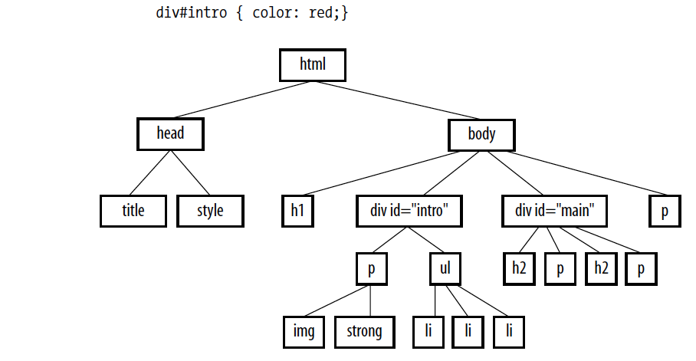
Group work
Circle all the elements in the diagram that you would expect to appear in red when the following style rule is applied to a document with the structure diagrammed below. This rule uses a type of selector you haven’t seen yet, but common sense should serve you well.

Slide 10
Formatting text

Slide 11
Font properties
font-family
font names, except generic families, are capitalized
should stack fonts
font-family: Futura, Univers, Geneva, sans-serif;
generic families: serif, sans-serif, monospace, cursive, fantasy
font-size
should use em or % specification (1em = 100% = default font size)
what is em? unit of measurement equal to current font size
when determining other sizes, use target/context = result
ex: page is using 16 pixels, you want article to be 14 pixels:
14/16 = .875

Slide 12
Font properties, cont’d
font-weight
normal, bold, lighter,…
font-style
normal, italic, oblique
font-variant
normal, small-caps
font
can do it all on one line
order is important: style, weight, variant, size, font-family
must have at least size and font-family
color
color value as name, rgb, hex or rgba

Slide 13
Selectors
Element selector
p { color: navy;}
Grouped selectors
p, h1 {color: navy;}
Descendant selectors
li em { color: navy;}
h1 em, h2 em, h3 em { color: navy;}
ID selectors
#catalog123 {color: navy;}
Class selectors
p.special {color: navy;}

Slide 14
Conflicting Styles Revisited
Hierarchy:
Individual element selectors
Contextual selectors
Class selectors
ID selectors
ID selectors have the highest precedence

Slide 15
Text Line Adjustments
line-height
use em or % to specify minimum height of a line (visually affects distance between two lines)
text-indent
em or % to specify value to indent first line of paragraph
may be a negative number
text-align
left, right, center, justify
horizontal alignment

Slide 16
Others
text-decoration
none, underline, overline, line-through, blink (don’t use)
text-transform
none, capitalize, lowercase, uppercase
letter-spacing
insert space between letters
word-spacing
insert space between words
list-style-type
none, disc, circle, square, decimal, decimal-leading-zero, lower-alpha, upper-alpha, lower-latin, upper-latin, lower-roman, upper-roman, lower-greek

Slide 17
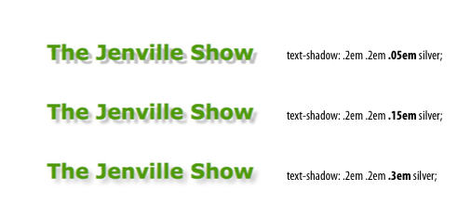
Shadow Text
text-shadow
horizontal offset, vertical offset, blur radius, color

